Slide 1
The Stagecoach Problem
A Dynamical Programming problem

Slide 2
A Minimum Path problem
Given a series of paths from point A to point B
A and B are not directly connected
Each path has a value linked to it
Find the best route from A to B

Slide 3
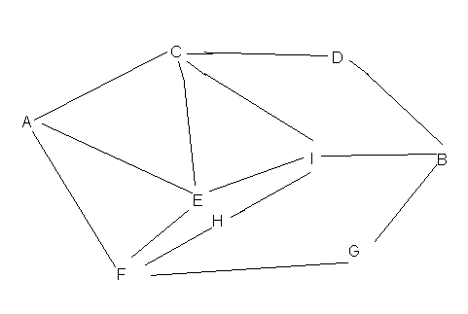
A sample minimum value route

Slide 4
The Stagecoach Problem
The idea for this problem is that a salesman is traveling from one town to another town, in the old west. His means of travel is a stagecoach. Each leg of his trip cost a certain amount and he wants to find the minimum cost of his trip, given multiple paths.

Slide 5
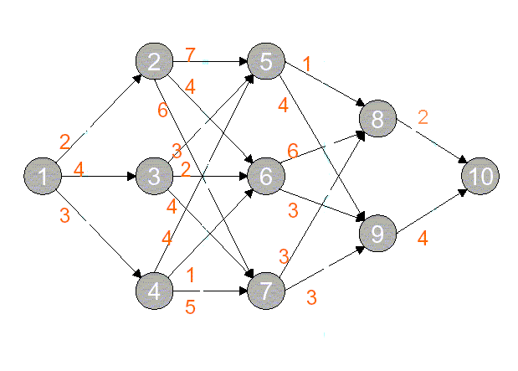
A sample stagecoach problem
Trying to get from Town 1 to Town 10

Slide 6
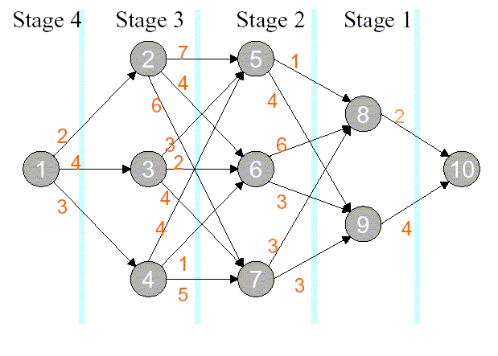
Begin by dividing the problem into stages like shown

Slide 7
Suppose you are at node i, you want to find the lowest cost route from i to 10
Start at node 10, and work backwards through the network.
Define variables such that:
cij = cost of travel from node i to node j
xn = node chosen for stage n = 1; 2; 3; 4
s = current node
Let fn (s; xn) be the total cost of the best path for stages n; n-1; . . . ; 1, where N = 4 is the total number of stages.
Let x*n denote the value of xn that minimizes fn (s; xn)
Let f*n(s)≡fn (s; x*n )

Slide 9
Start at Stage 1 (the last stage). Then
s | f*1(s) | x* 1
8 | 2 | 10
9 | 4 | 10
At Stage 2 we compute f2(s; x2) = csx2 + f*1 (x2) for all possible (s; x2)
At Stage 3 we compute f3(s; x3) = csx3 + f*2 (x3) for all possible (s; x3)
At Stage 4 we compute f4(s; x4) = csx2 + f*3 (x4) for all possible (s; x4)

Slide 10
Working forwards from stage 4 to stage 1 you follow the best route from the tables.
You then add up the numbers along the route and get you best solution from the problem

Slide 11
Still in Use
This problem can be used in Computer Networks
Plane travel
Many other applications

Slide 12
The Stagecoach Problem
A Dynamical Programming problem

